Slide 1
Text preprocessing
An academic guide for business users with a case study

Slide 2
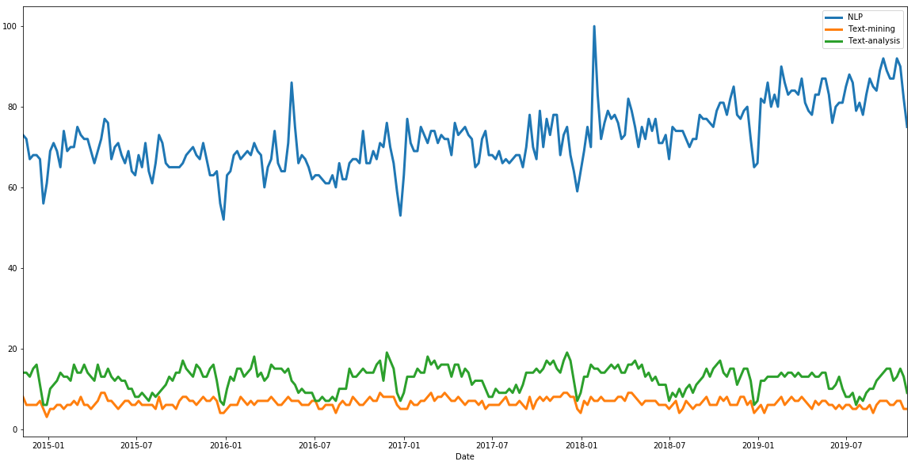
Interest over time

Slide 3
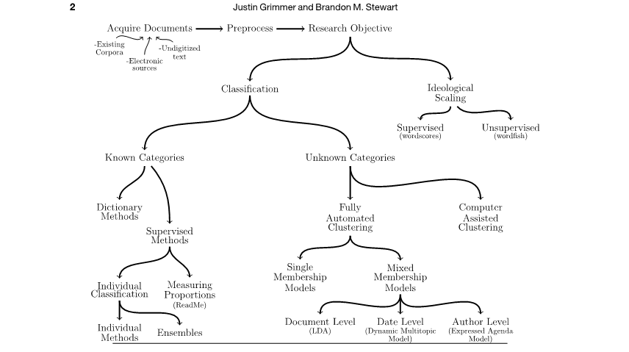
Text mining in academia

Slide 4
Ideological scaling
Wordfish model (unsupervised)

Slide 5
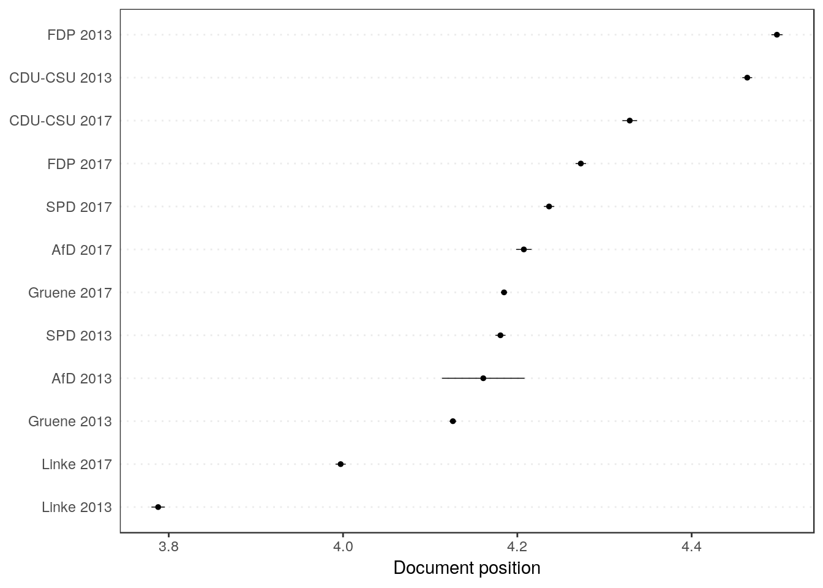
Ideological scaling
Wordfish model (unsupervised)
Wordscore (supervised)

Slide 6
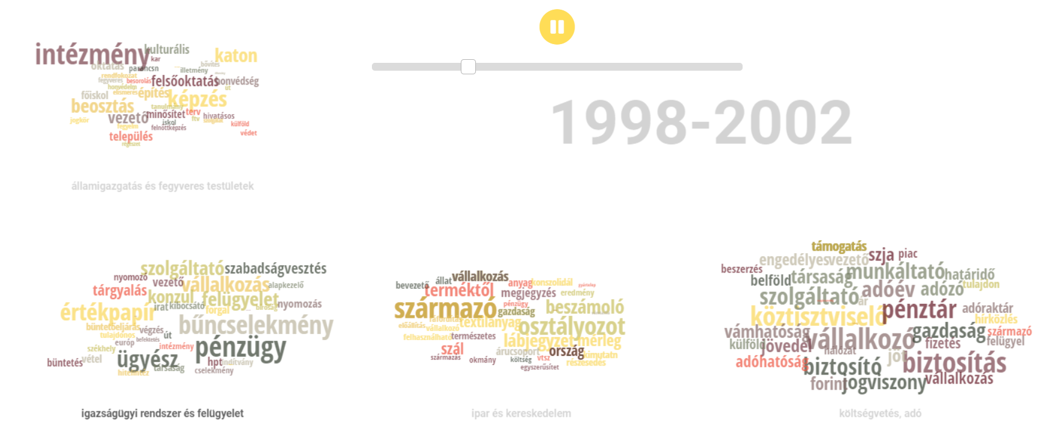
Topic modeling
A Hungarian Academy of Sciences - Centre for Social Sciences project

Slide 7
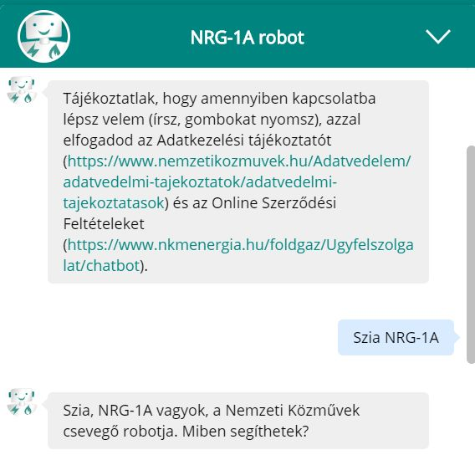
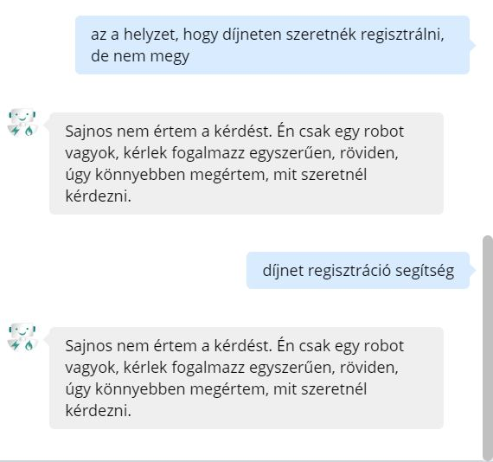
Text mining in business
Chatbots
Me: I’d like to register on díjnet, but I cannot.
Bot: I don’t understand. Say it more simply.
Me: díjnet, registration, help
Bot: I don’t understand. Say it more simply.

Slide 8
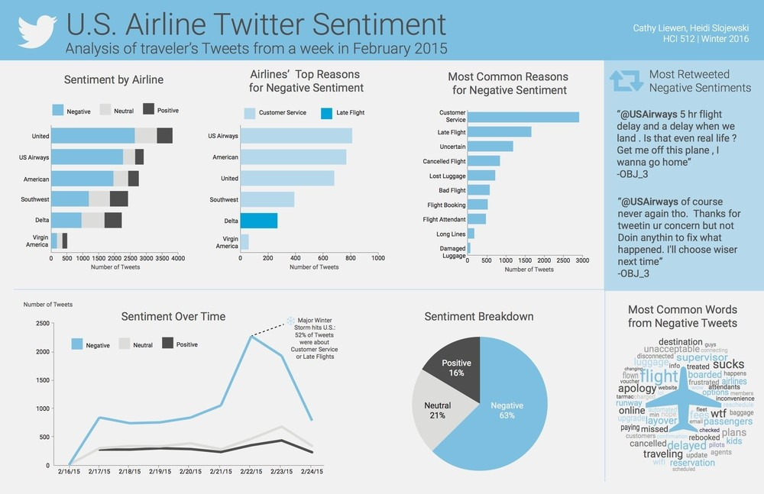
Sentiment analysis

Slide 9
Preprocessing techniques I.
Punctuation and special characters
<h1>This is a heading with html markup</h1> -> This is a heading without html markup.
Let’s roll out to party! ☺#highlife -> Let’s roll out to party highlife
Numbers
Assga
AGAG
Lower-casing
Rose likes to read books. -> rose likes to read books
Rose, a flower I like. This is a rose. -> rose, a flower i like. this is a rose

Slide 10
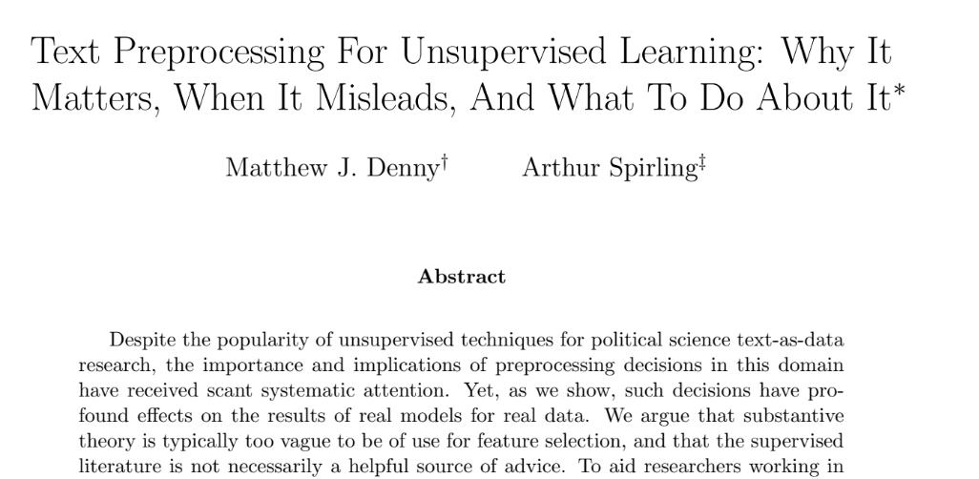
Preprocessing techniques

Slide 11
Preprocessing techniques I.
Punctuation and special characters
<h1>This is a heading with html markup</h1> -> This is a heading without html markup.
Let’s roll out to party! ☺#highlife -> Let’s roll out to party highlife
Numbers
Assga
AGAG
Lower-casing
Rose likes to read books. -> rose likes to read books
Rose, a flower I like. This is a rose. -> rose, a flower i like. this is a rose

Slide 12
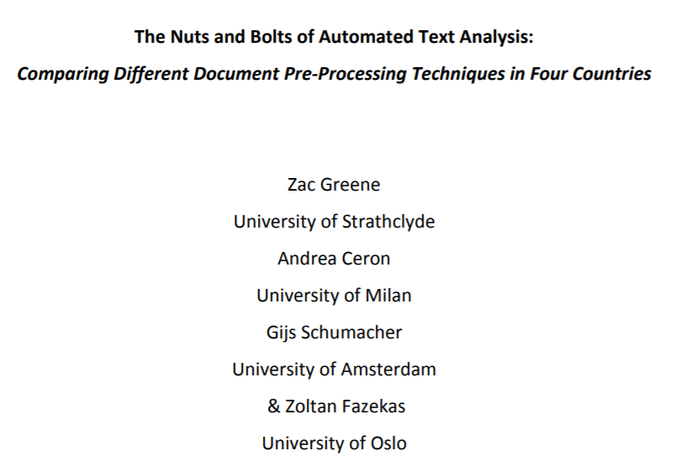
Preprocessing techniques

